Slide 1



The Extra Point
IST 652 Scripting for Data Analysis
Prepared by:
Nabeel Khan
Renjini Rajan
Amanda Norwood
December 8th 2022
https://www.nfl.com/
Notes:
Project on insights into nfl games
4 team members

Slide 2
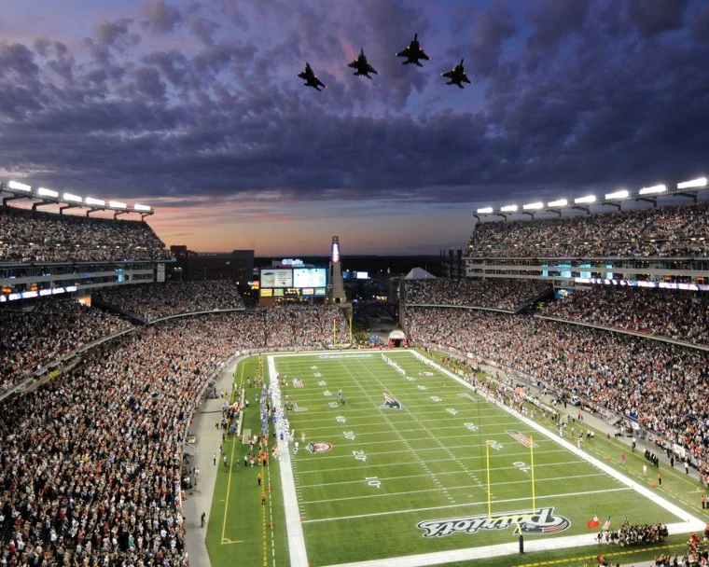
SCOPE OF PROJECT
The goal is to provide various NFL personnel and fans of the game with statistics and information that potentially impact game outcome and decision making in various areas, i.e.:
Stadium Type
Surface Type
Training Needs
Specific questions were brought forth for potential hypothesis testing through the use of multiple data sources

Slide 3
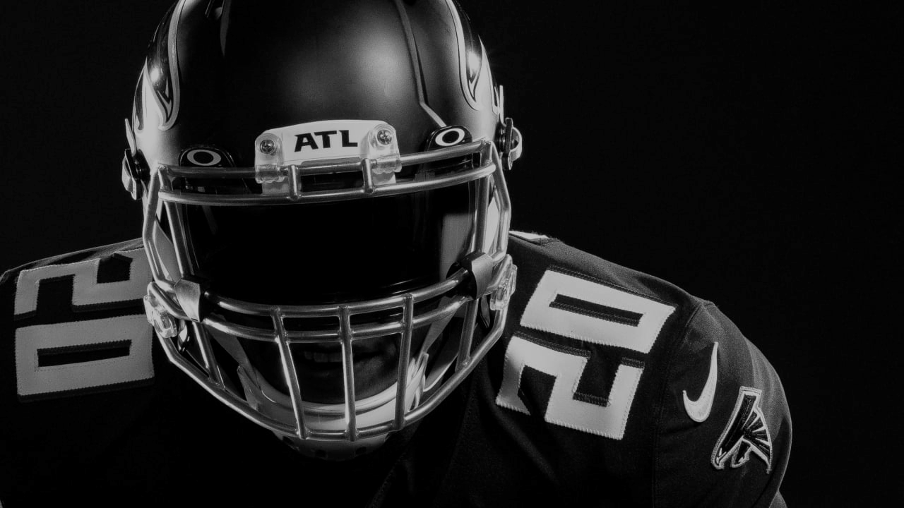
Data Sources and Cleansing
Data sources: Kaggle and Github
NFL Games (1999 to present) 6409 rows, 44 columns
NFL Statistics (2019 to present) 896 rows, 20 columns
NFL Teams
Team names, team abbreviation, division, conference
Special Teams (2000-2016) 568 rows and 26 columns
Data Cleansing
Clean up null fields
Replace null fields with 0s
Merge NFL Games & NFL Statistics (on Teams)
Create boolean fields for certain statistics
Subset data to refine the scope of analysis (seasons included)
Notes:
NFL Games since 1999 to present
6409 rows, 44 columns → team names, quarterback games, coach games, home/away score, data of game, type of surface field, and name of stadium
NFL Statistics since 2019 to present
896 rows, 20 columns → winner, pass yards, rush yards, total yards, total first downs, team ranking
NFL Teams
Team names, team abbreviation, division, conference
Statistics: boolean fields such as outdoor indoor and then W/L

Slide 4

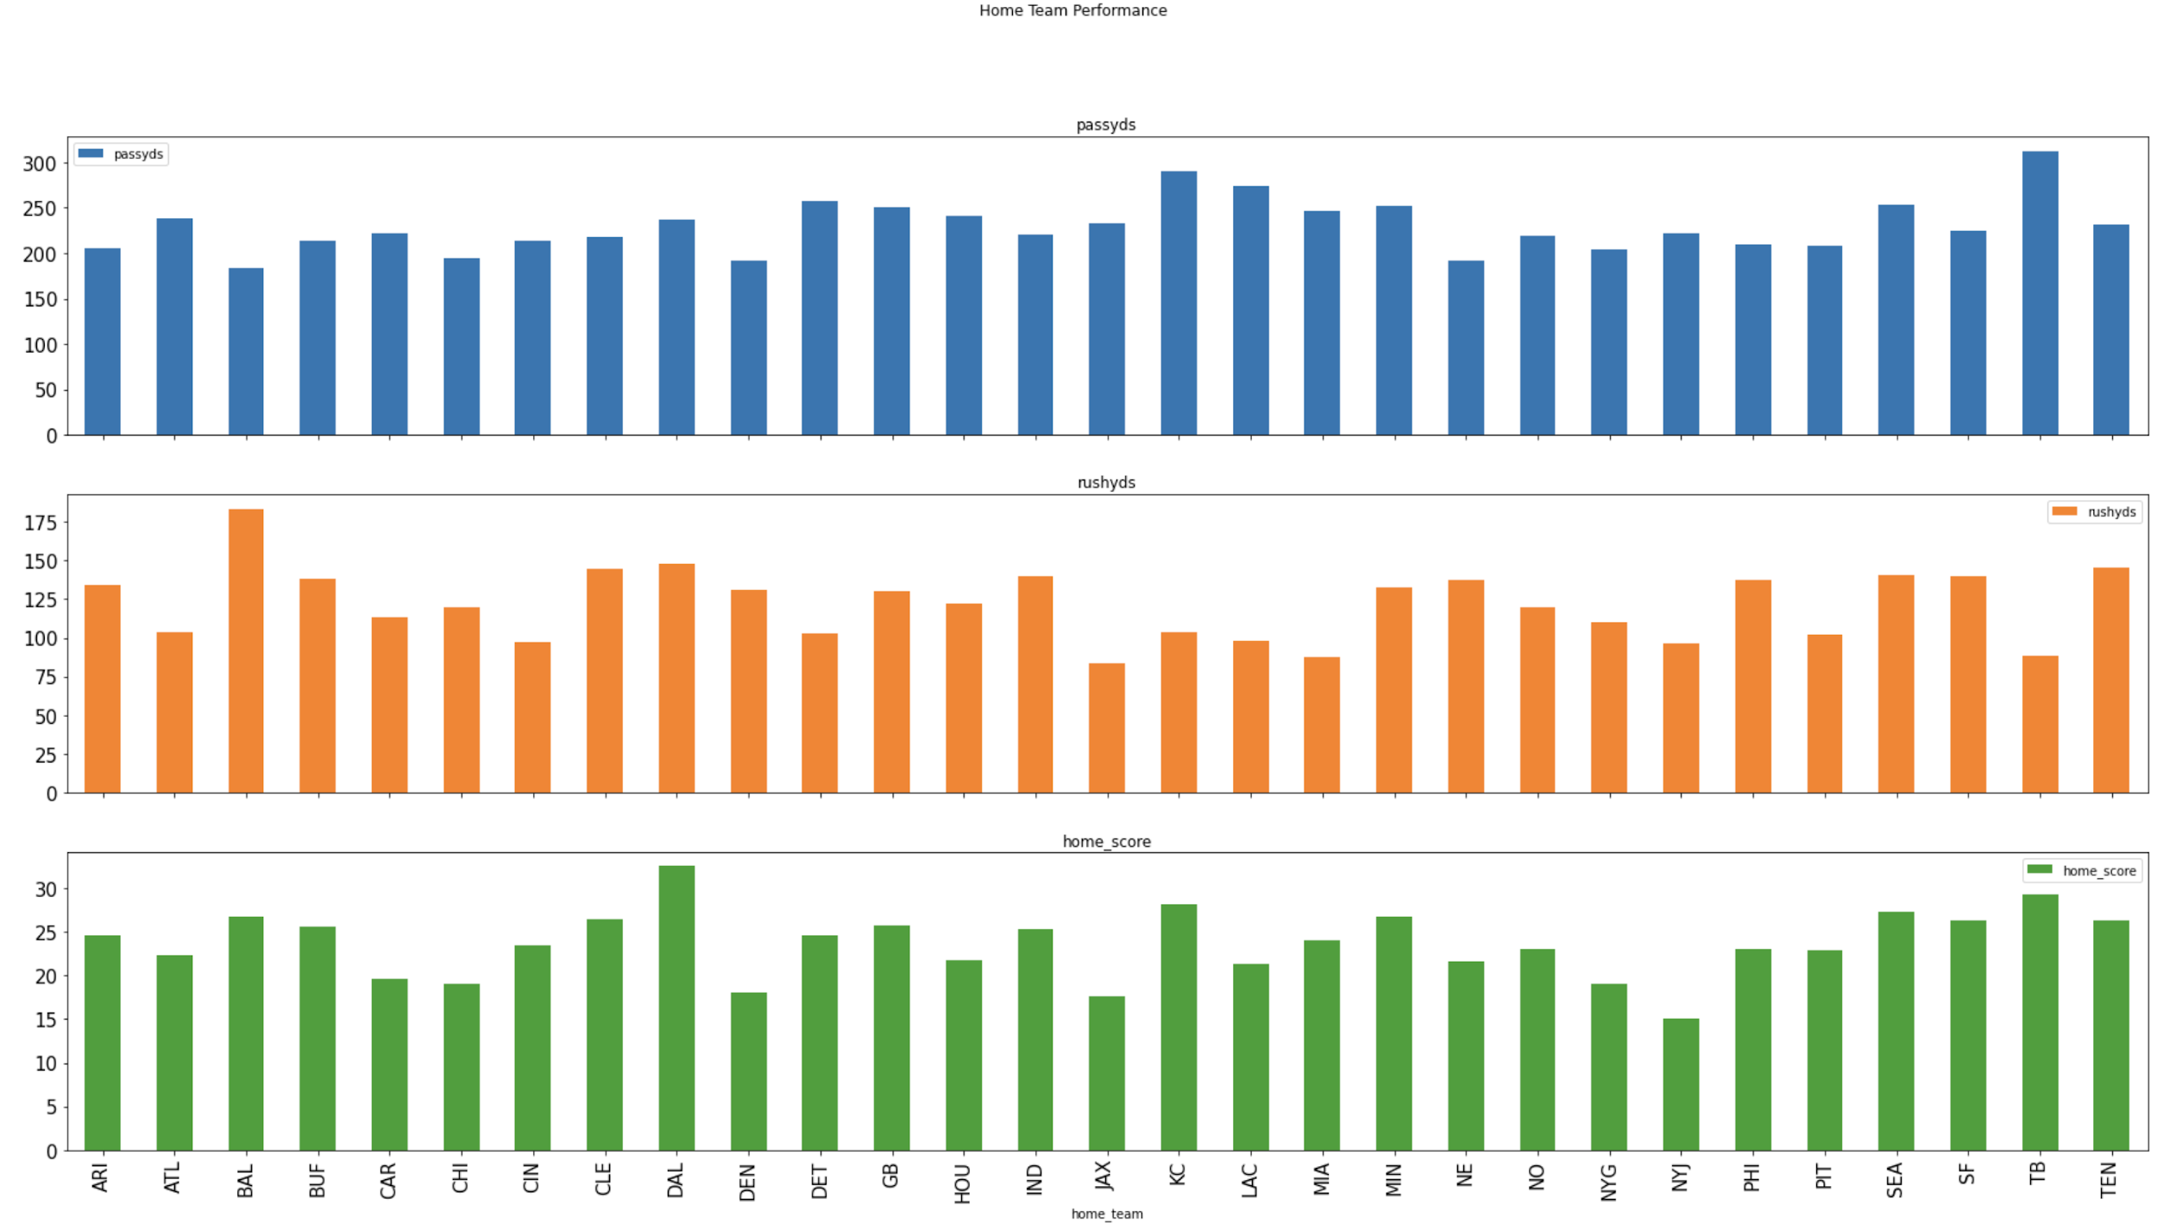
Overall Home Team Performance
Passing yards, rushing yards and home score

Slide 5
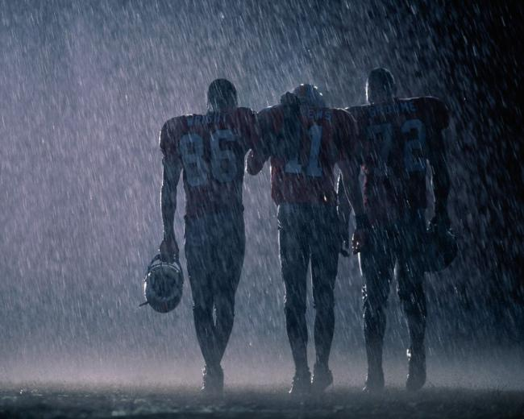
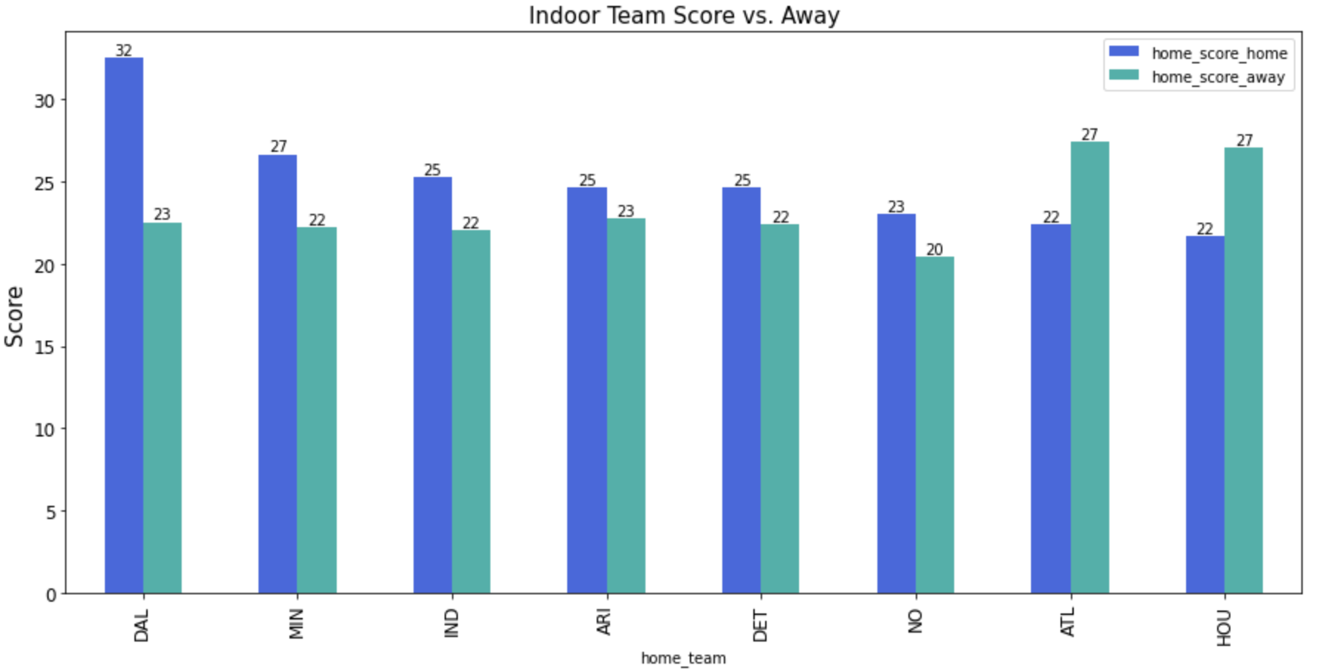
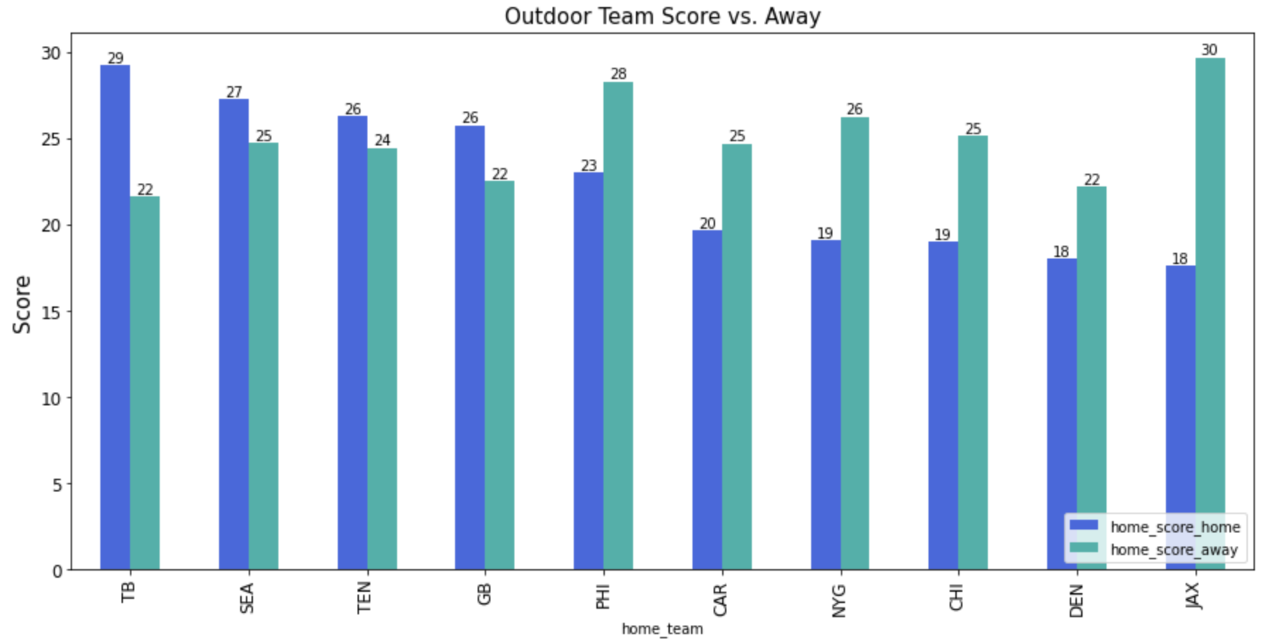
How do teams perform with Indoor/Outdoor environments?
Teams with an indoor stadium generally play better at home than away.
However, there is no data that shows that teams with an outdoor stadium perform better or worse when they are away.

Slide 6

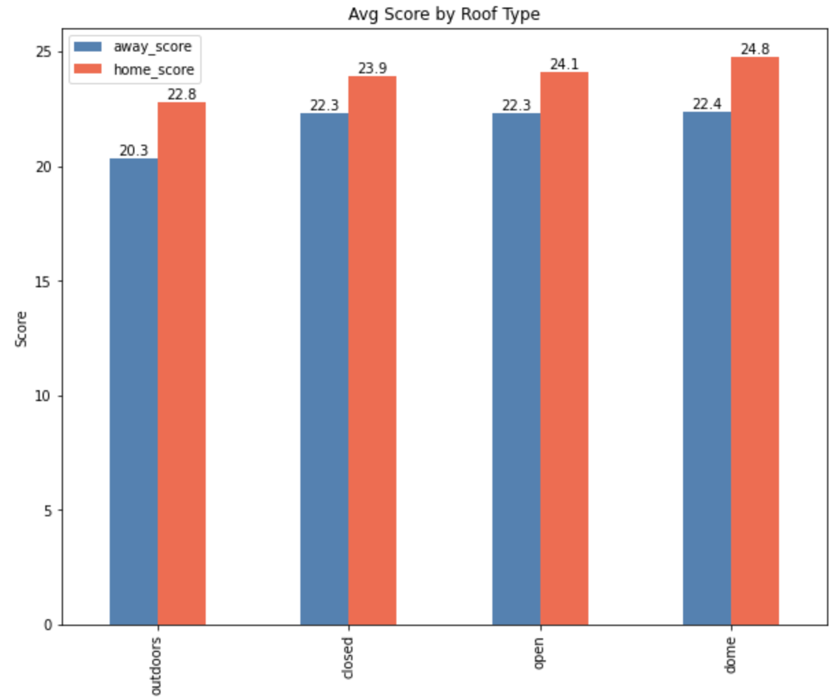
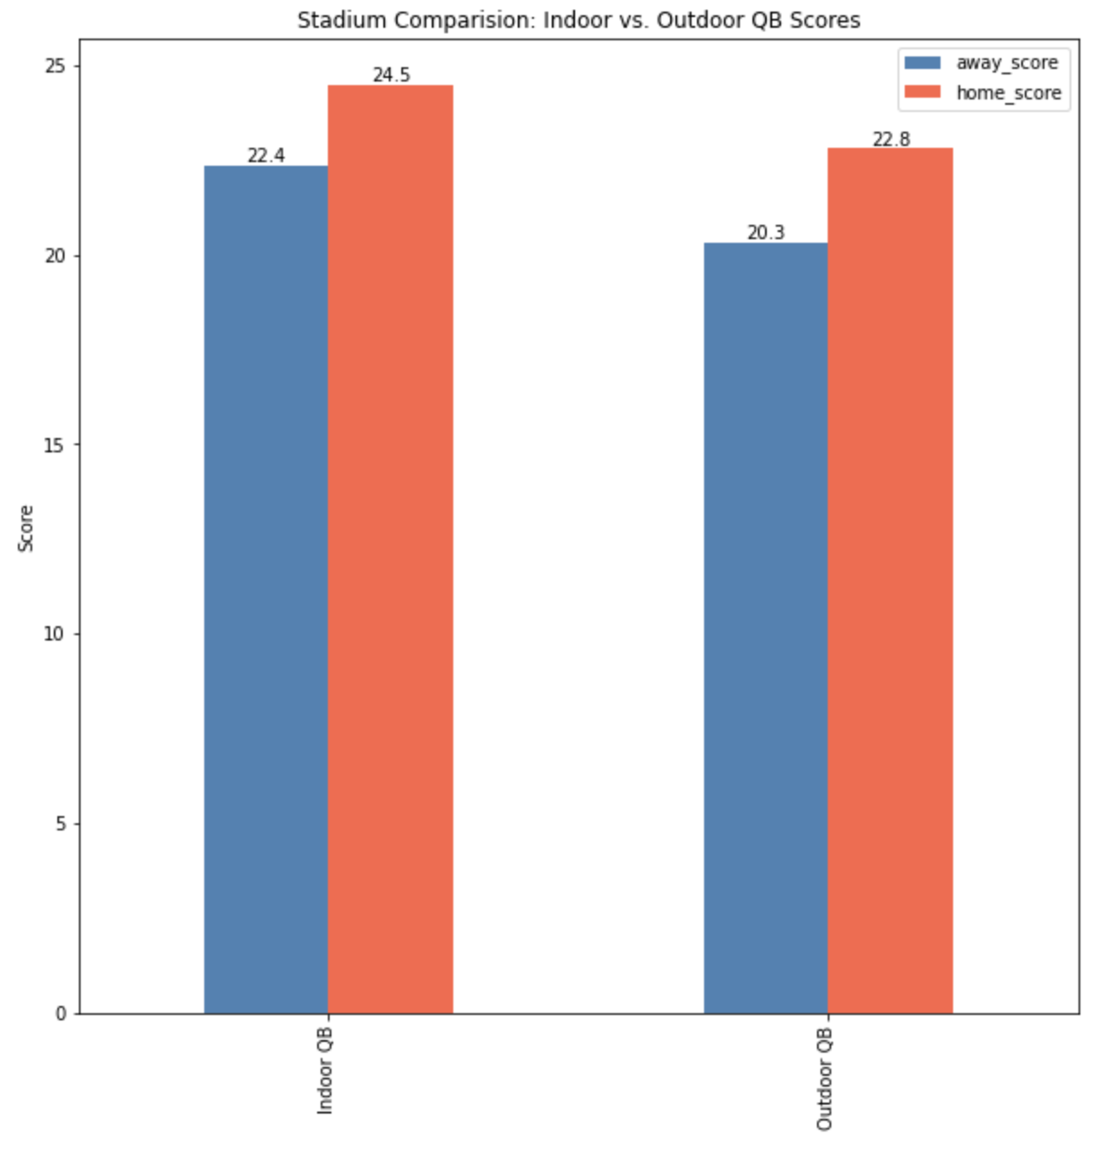
Indoor vs. Outdoor Stadiums
We can also see that when teams play outdoors, they tend to score less than playing indoors.
Data shows that outdoor stadiums yield less points overall than closed, open, or dome stadiums.

Slide 7
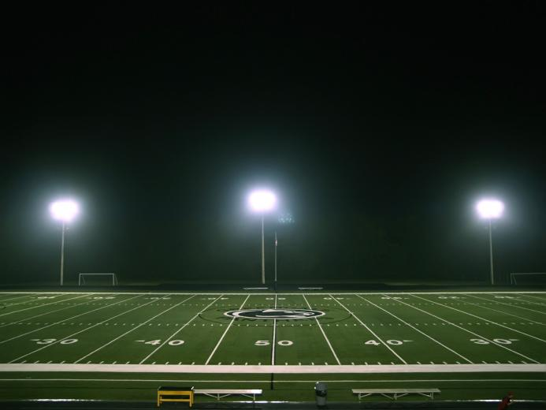
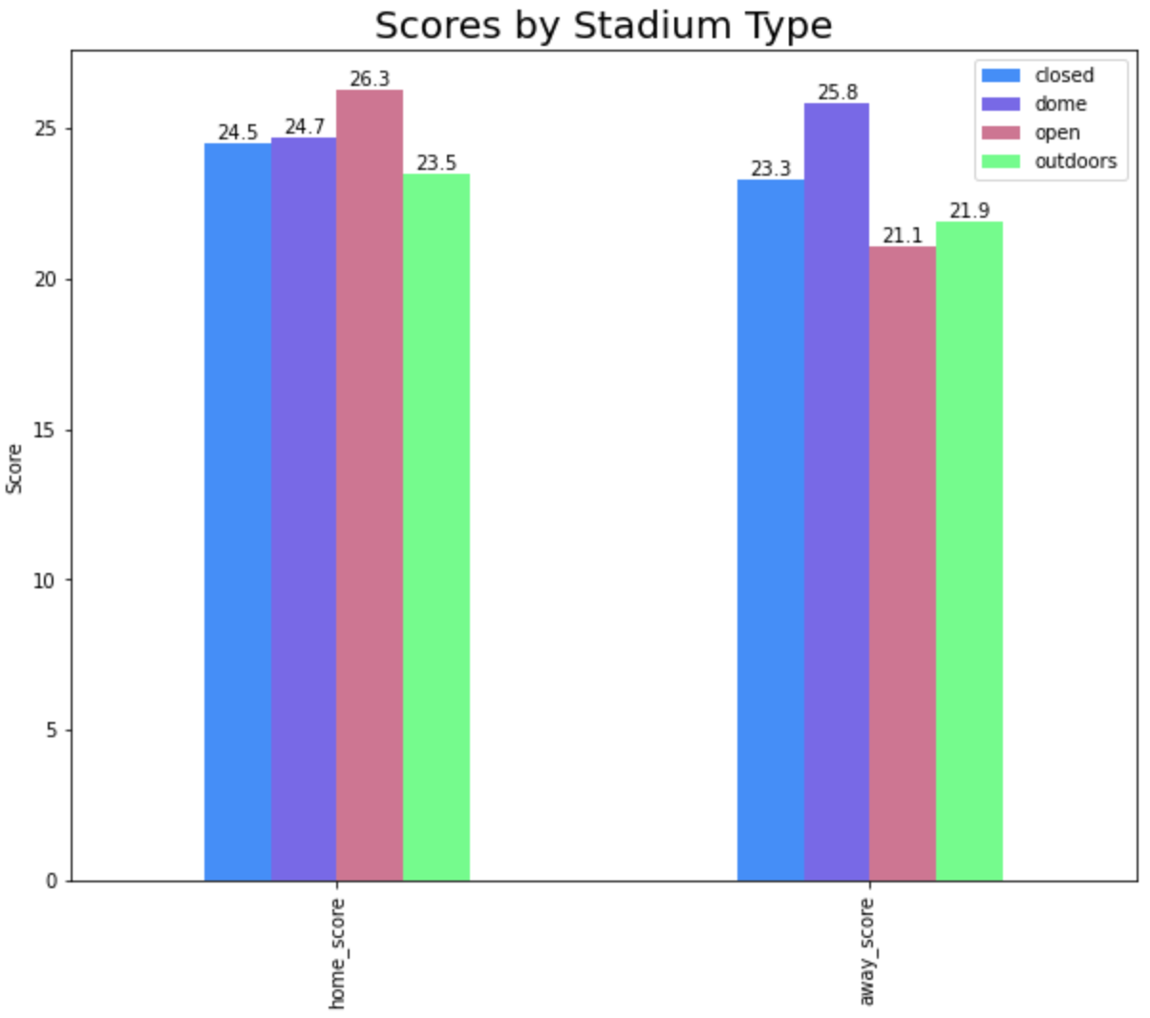
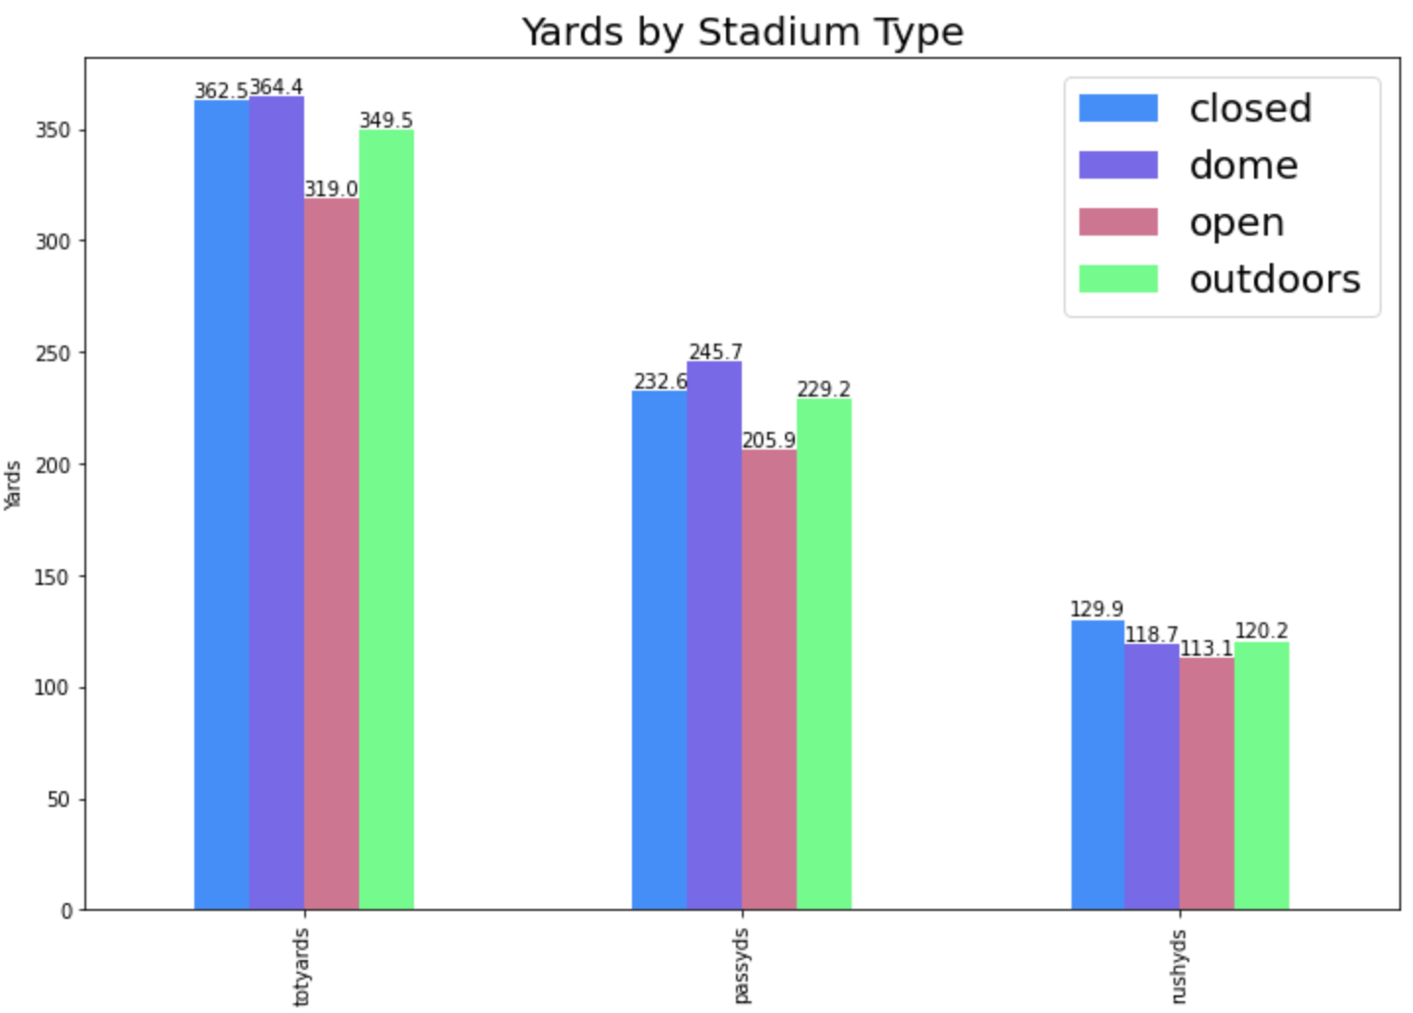
Scores and Yards Comparison by Stadium Type
More yards does not equal more points.
Total yards for games played in outdoor stadiums are ranked ¾ but in terms of home score, they rank last.
As for open air stadiums, they have the fewest total yards but have the highest average home score.

Slide 8
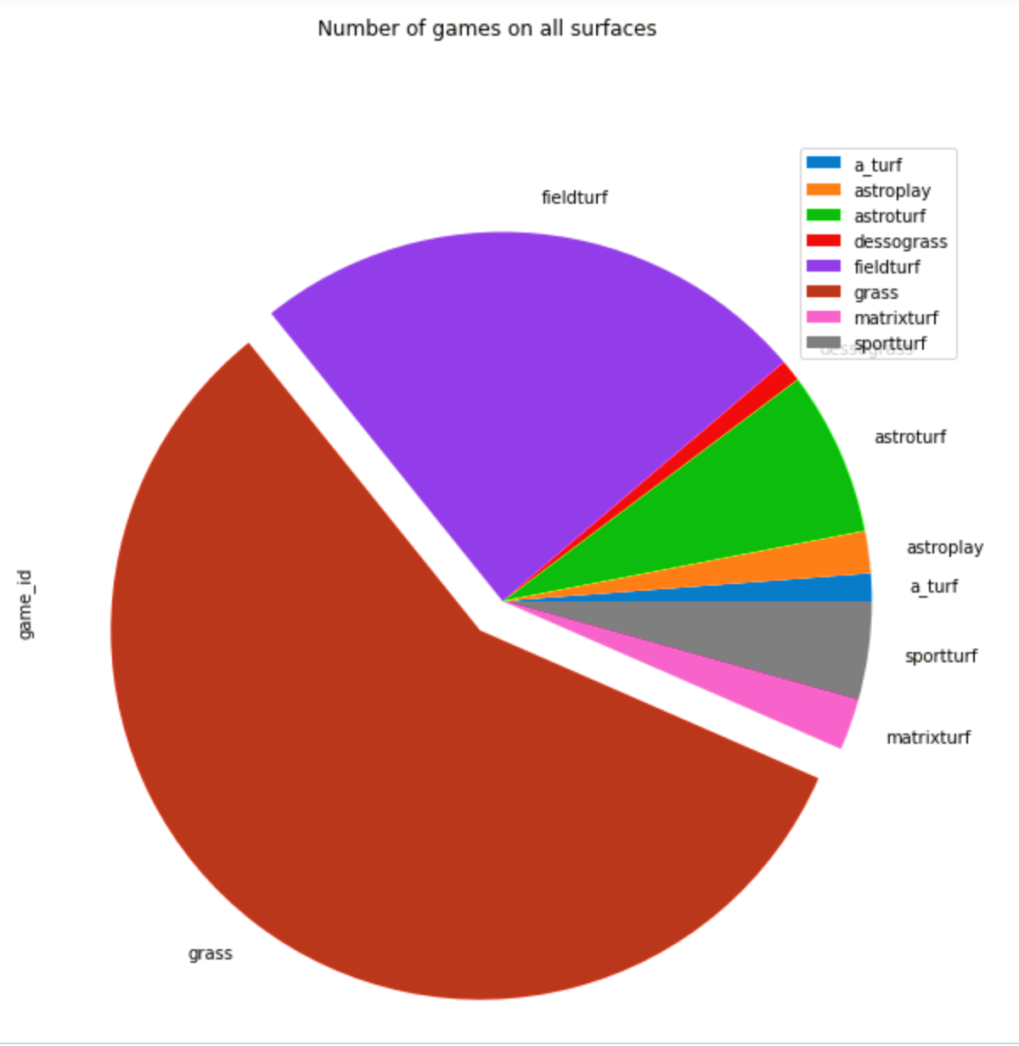
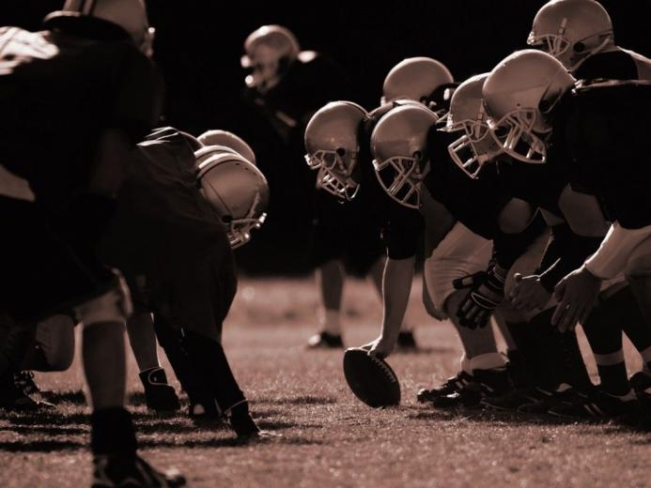
EFFECTS OF FIELD SURFACE ON GAMES
Type of surface (grass vs turf) does not contribute significantly on the performance

Slide 9
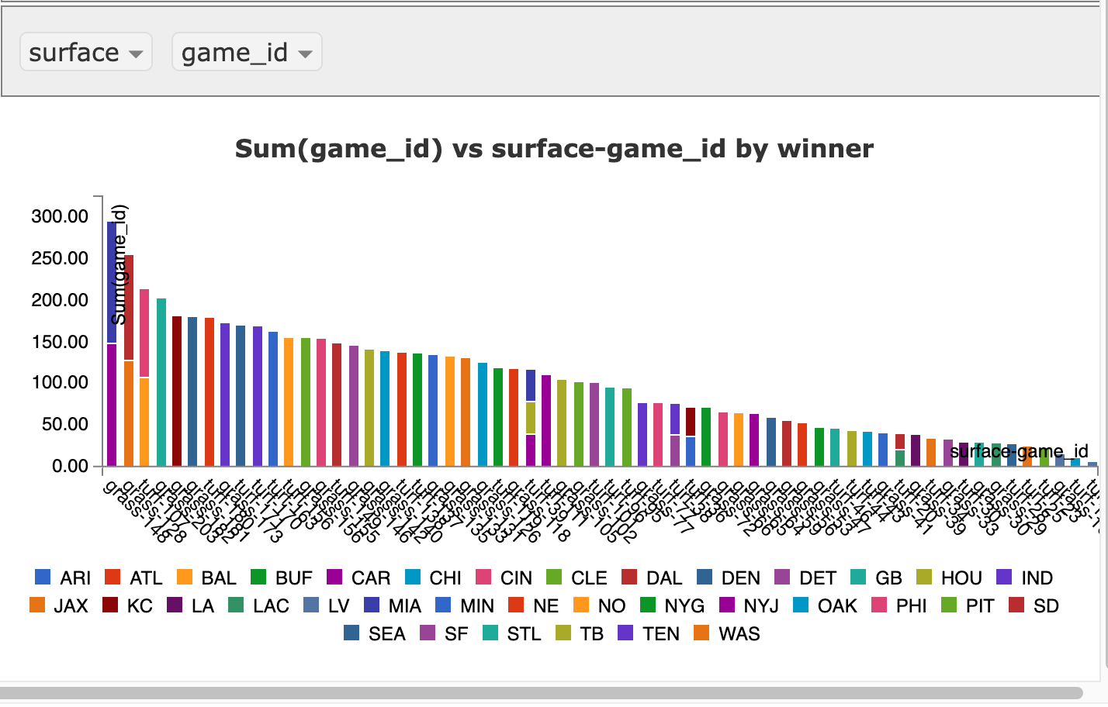
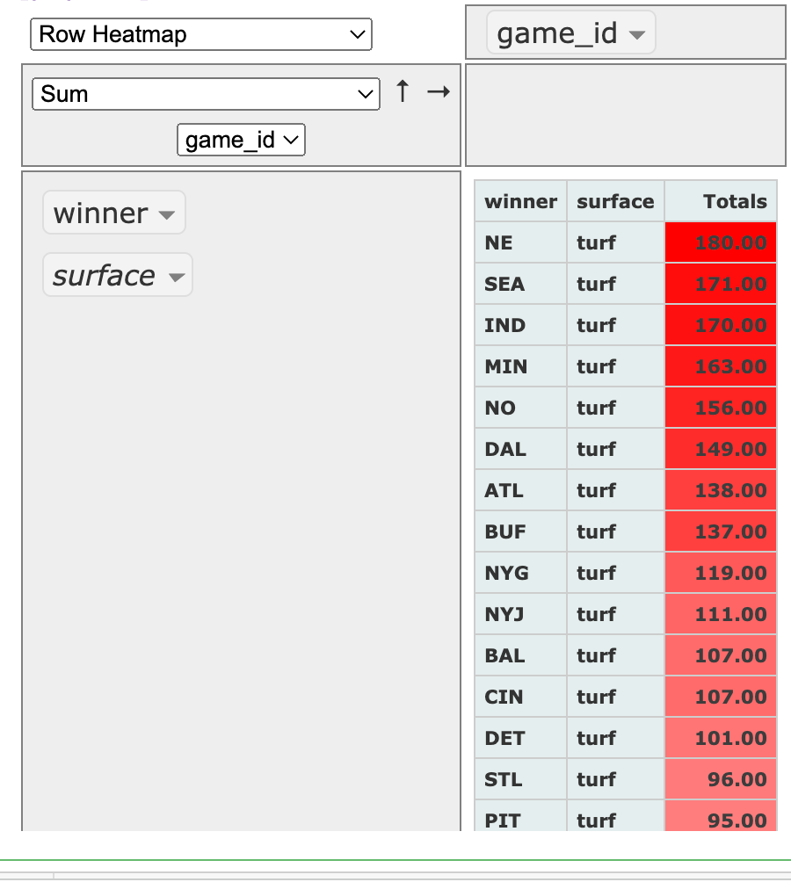
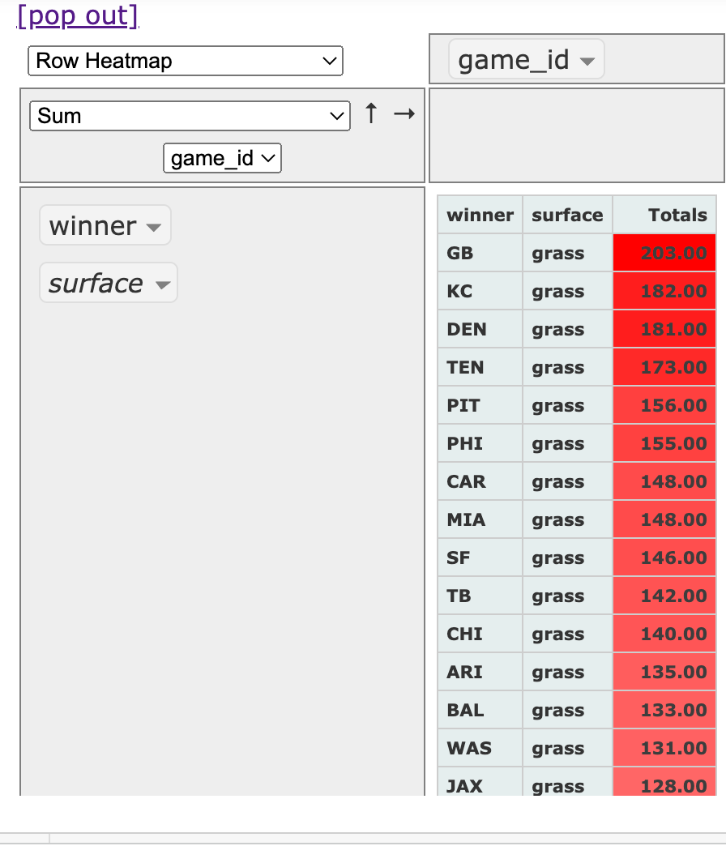
SOME SURFACE STATISTICS
Overall Team Stats
Turf Winners
Grass Winners
Notes:
Further Research - It may not be related to scoring, but a recent study conducted by nfl, shows less injuries on turf when compared to grass. Need to source the data and look for trends supporting safety of players

Slide 10
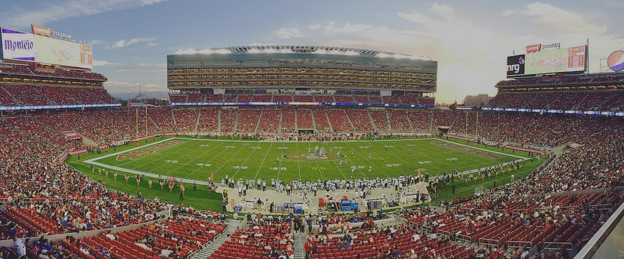
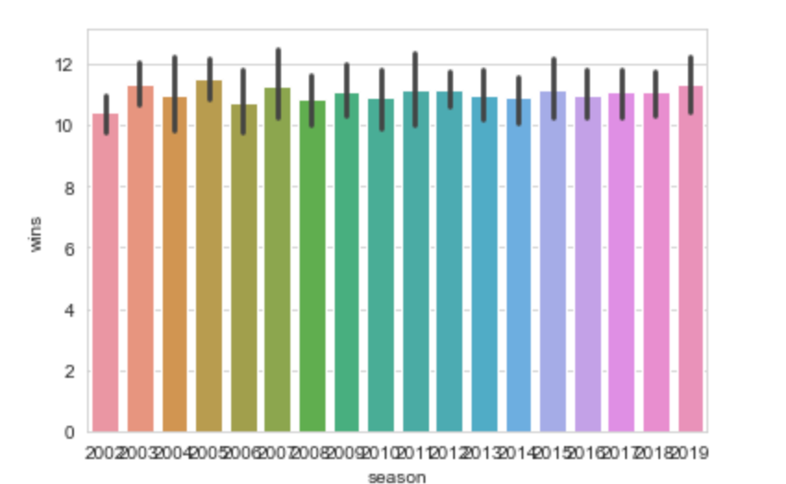
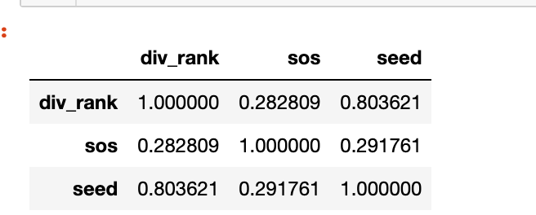
Playoff Statistics
Some Performance Stats on the teams who reached playoffs
To Assure ‘Playoffs:’ Approximate ‘12’ wins during the Reg Seasons
Correlation between rank and win rate(sos)

Slide 11
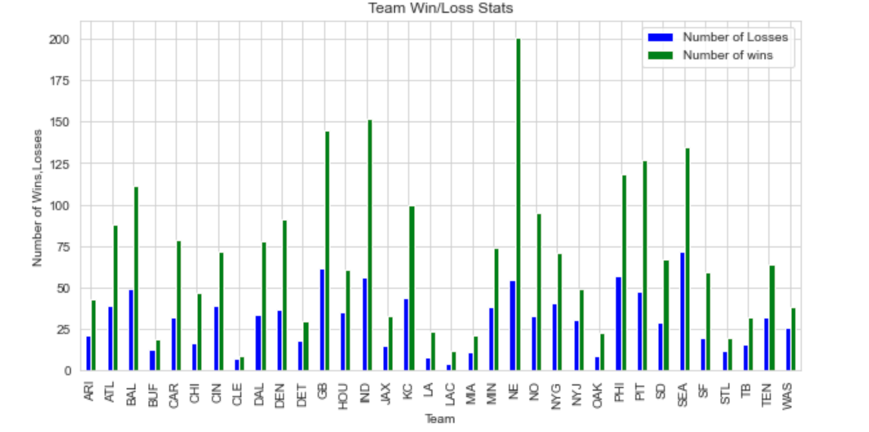
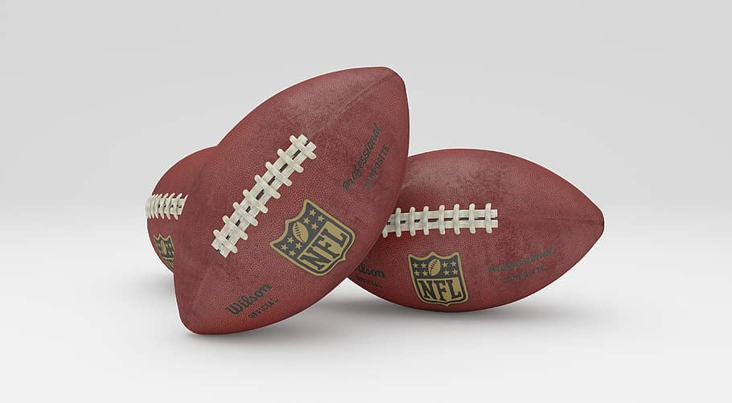

Playoff Statistics
How did the teams performed over the Years??

Slide 12
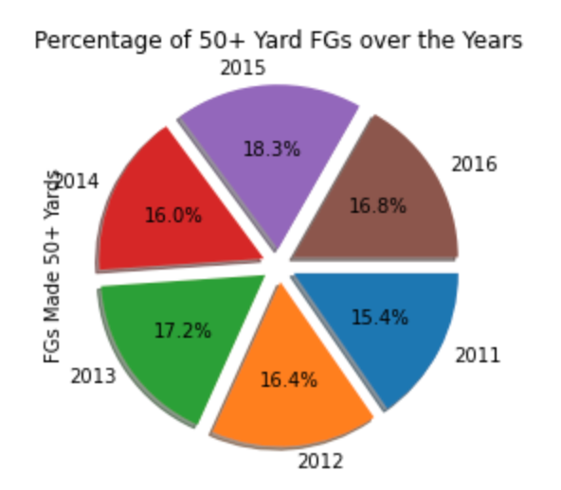
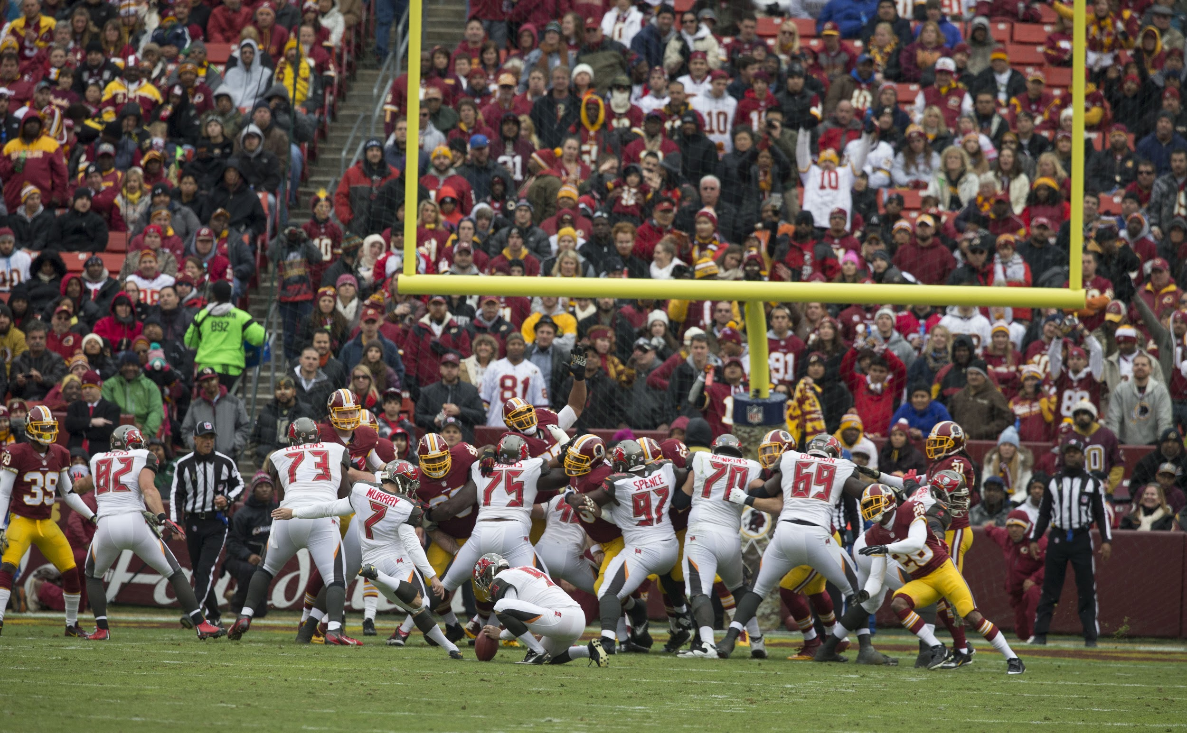
Special Team Effects!!
– Sometimes missing a Field Goal can cost you a Game!!
Who scored the longest FG?
Per our analysis:
Year: 2013
Team: Denver Broncos
Player: Matt Prater
Distance: 64 yds
Recent Field Goals Scoring Trends show that each team really want to try out for those extra points.
Notes:
In 2022, By Week 3 of last season, Justin Tucker etched his name in the record books with a game-winning 66-yard field goal to lift the Baltimore Ravens over the Detroit Lions, passing kicker Matt Prater’s eight-year record in the process

Slide 13
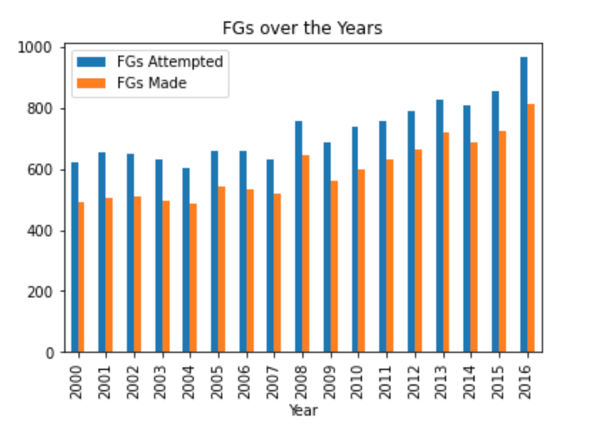
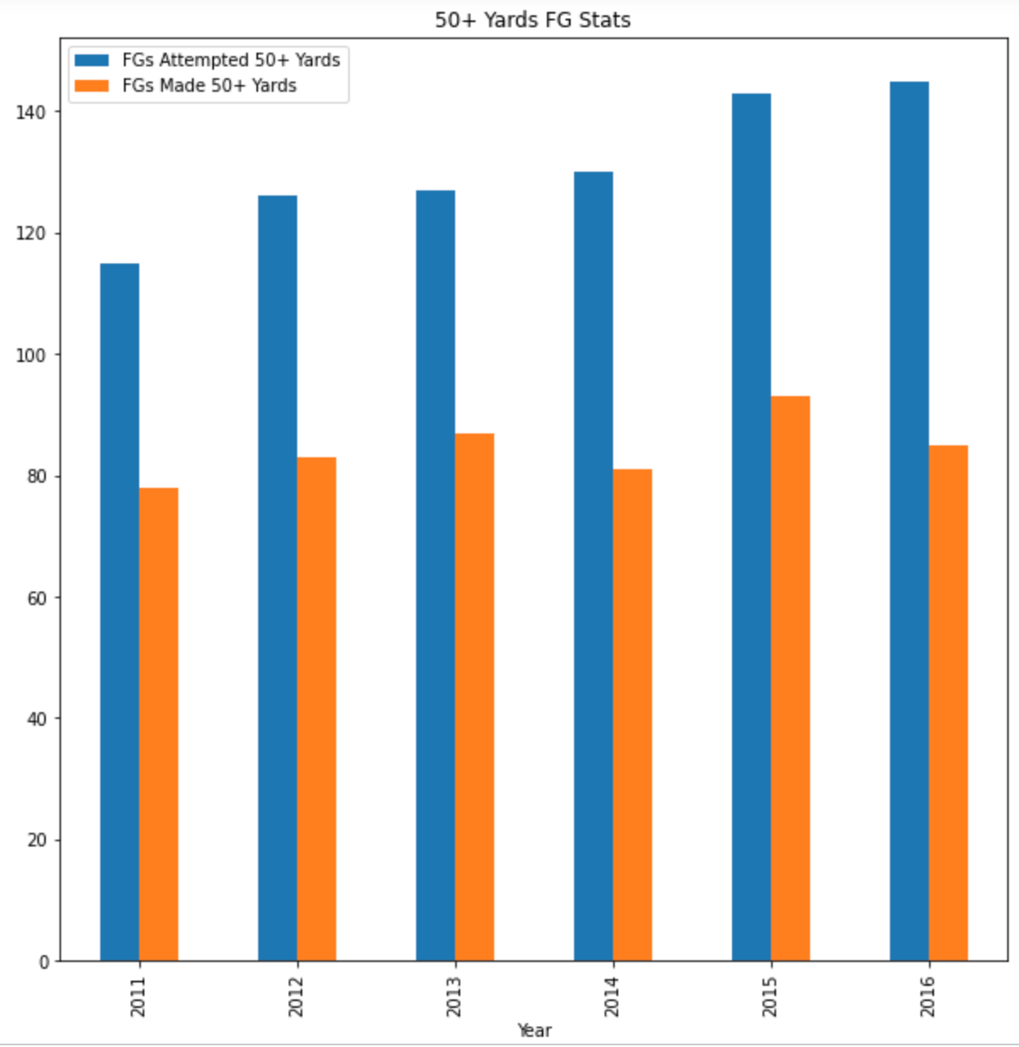
Special Team Effects!!
– Sometimes missing a Field Goal can cost you a Game!!
The trends are obviously favoring additional training and benefits that teams should invest into to sharpen the special skills
Notes:
Further Research - statistics to incorporate all other speciality teams and analyze a trend

Slide 14
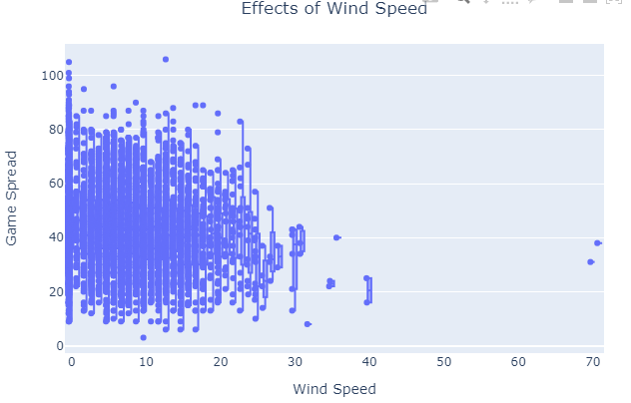
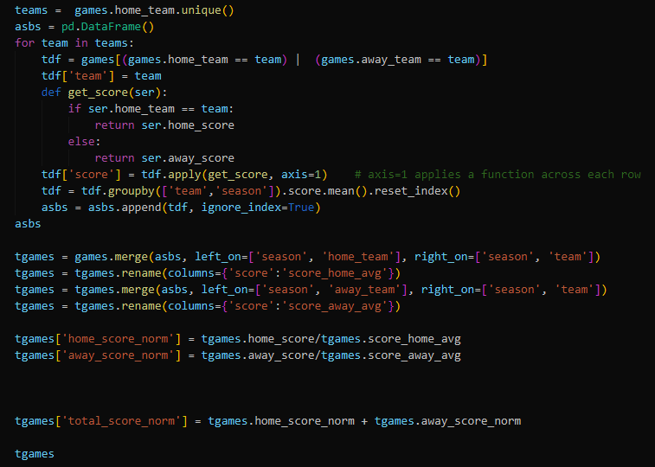
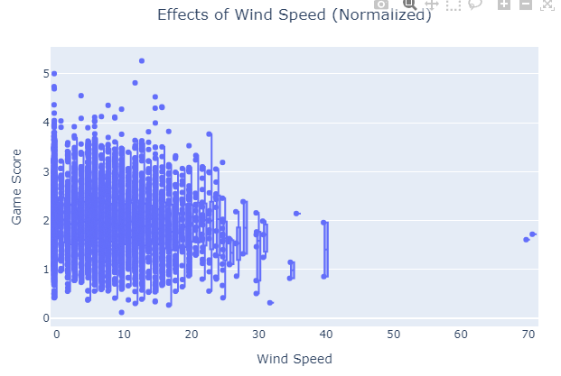
HOW DOES WIND EFFECT THE HOME TEAM?
Wind does not seem to provide a strong correlation to scoring
Dataset normalization does not show any significant correlation

Slide 15

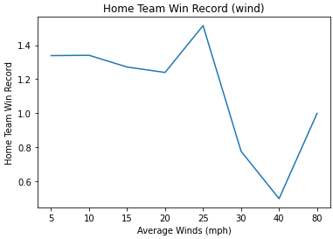
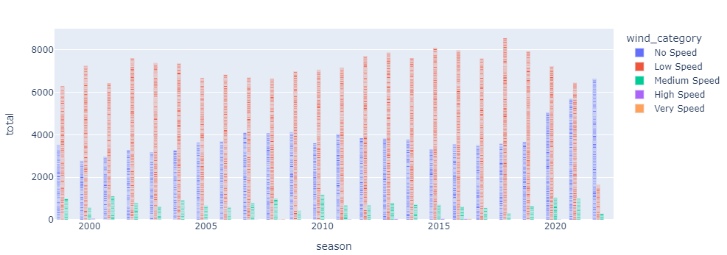
HOW DOES WIND EFFECT THE HOME TEAM?
Running a correlation on scoring and winds, it reveals there is increased scoring in less windy conditions.
Additionally, the trend of low wind speeds to high scoring seems to be increasing in recent seasons.

Slide 16
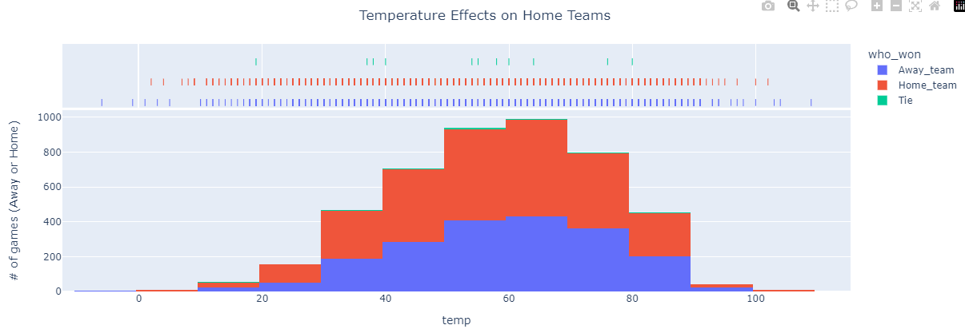
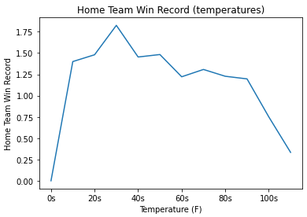
HOW DOES TEMPERATURE EFFECT THE HOME TEAM?
Short Answer: Not often
Long Answer: Environmental factors do not play a significant role in the spread of game points between teams. Temperature and field surface were found to only account for 2.5% of the variation in game point spread.

Slide 17
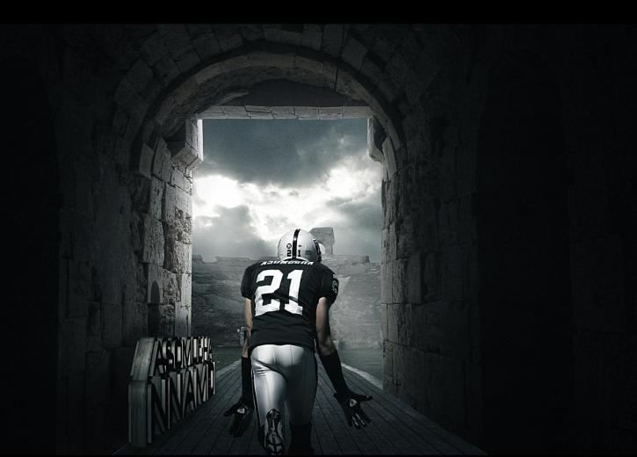
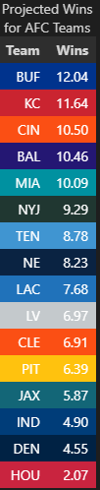
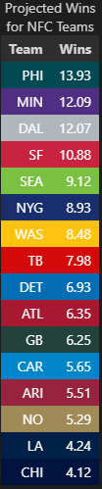
PROJECTED WINS FOR CURRENT SEASON
Pythagorean Expectations
Notes:
Pythagorean expectation is a sports analytics formula devised by Bill James to estimate the percentage of games a baseball team "should" have won based on the number of runs they scored and allowed. Comparing a team's actual and Pythagorean winning percentage can be used to make predictions and evaluate which teams are over-performing and under-performing. The name comes from the formula's resemblance to the Pythagorean theorem.^{[1]}

Slide 18

HOW CAN THESE RESULTS BE USED?
Indoor Stadiums tend to support teams for better wins while home and away
Surface Type (grass vs. turf) do not yield any conclusive evidence on influencing performance
Special Teams (Field Goals) tend to contribute more to overall scores/wins
Regular Season Performances improves the Rankings which in turn adds to home ground advantages
Temperature & Wind Speed do not yield significant benefits towards the performance
Future Enhancements to improve the Analysis Results:
Recent Studies conducted by NFL points out that Turf Surfaces are prone to less injuries.
Additional data on player injuries need to be added to enhance the analysis
Special Team Statistics can be expanded to include other specialities (punts, kickers, fumbles etc.) to enhance the training needs
Expand our datasets to including a modeling tool that depicts several factors to predict game outcome

Slide 19

THANKS
Prepared by:
Nabeel Khan
Renjini Rajan
Amanda Norwood
Credits
Images: https://wallpapersafari.com/ https://www.nfl.com/
END OF PRESENTATION

